Slide 1
Universidad de Jaén
committed to your future!

Slide 2
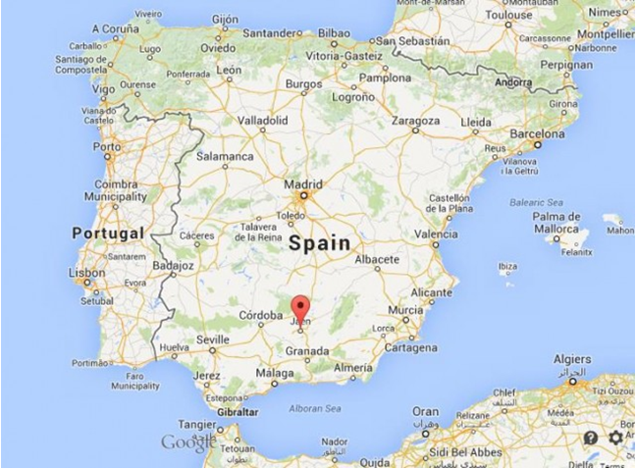
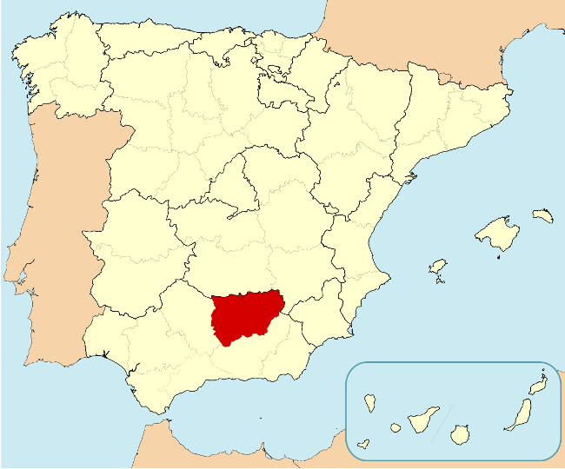
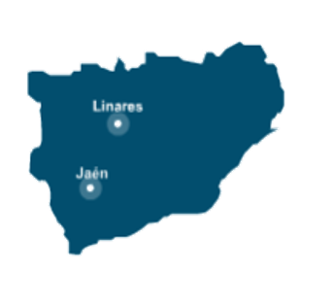
Universidad de Jaén
Where are we?
Located in the region of Andalusia
the province of Jaén has a population of 650,000, including Jaén (120,000) and Linares (65,000).
320 km from Madrid, 246 km from Seville, 202 km from Malaga, 89 km from Granada

Slide 3
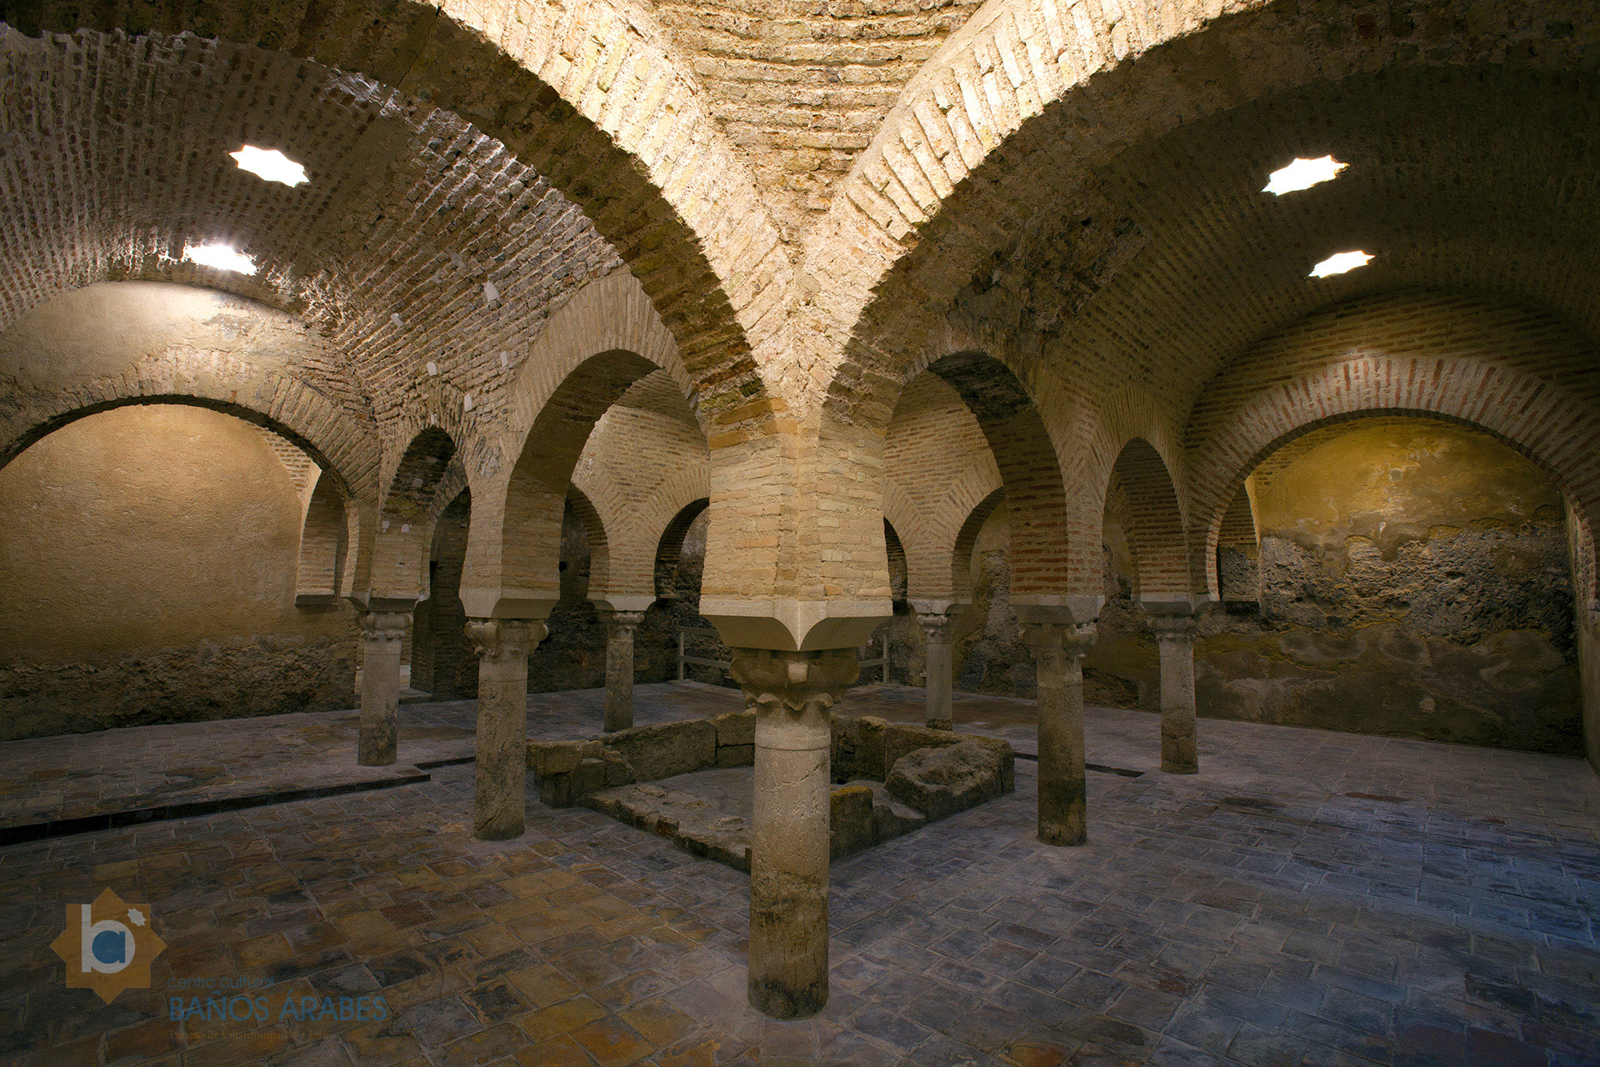
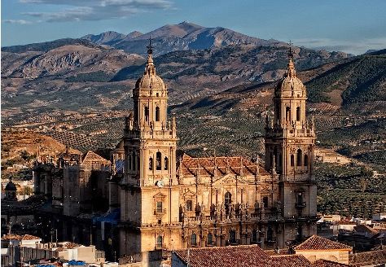
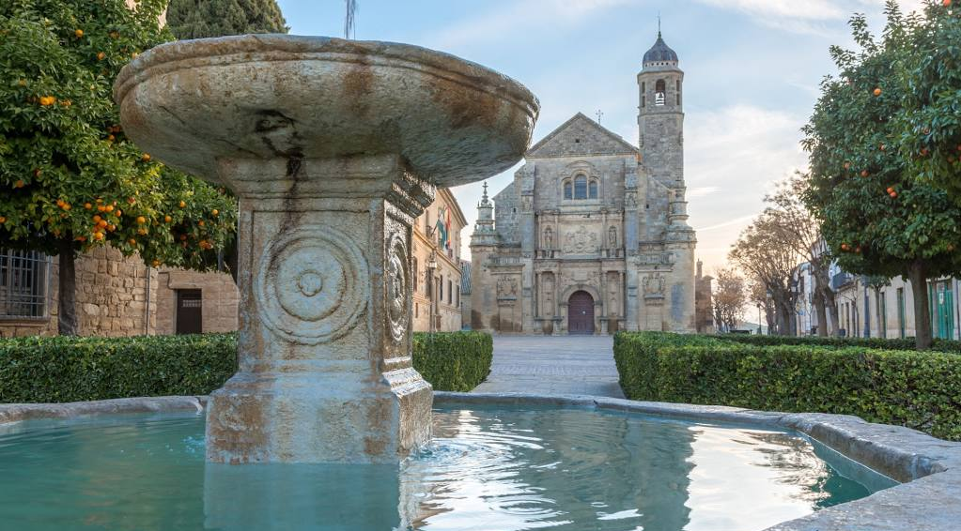
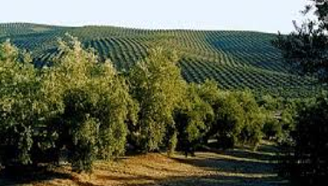
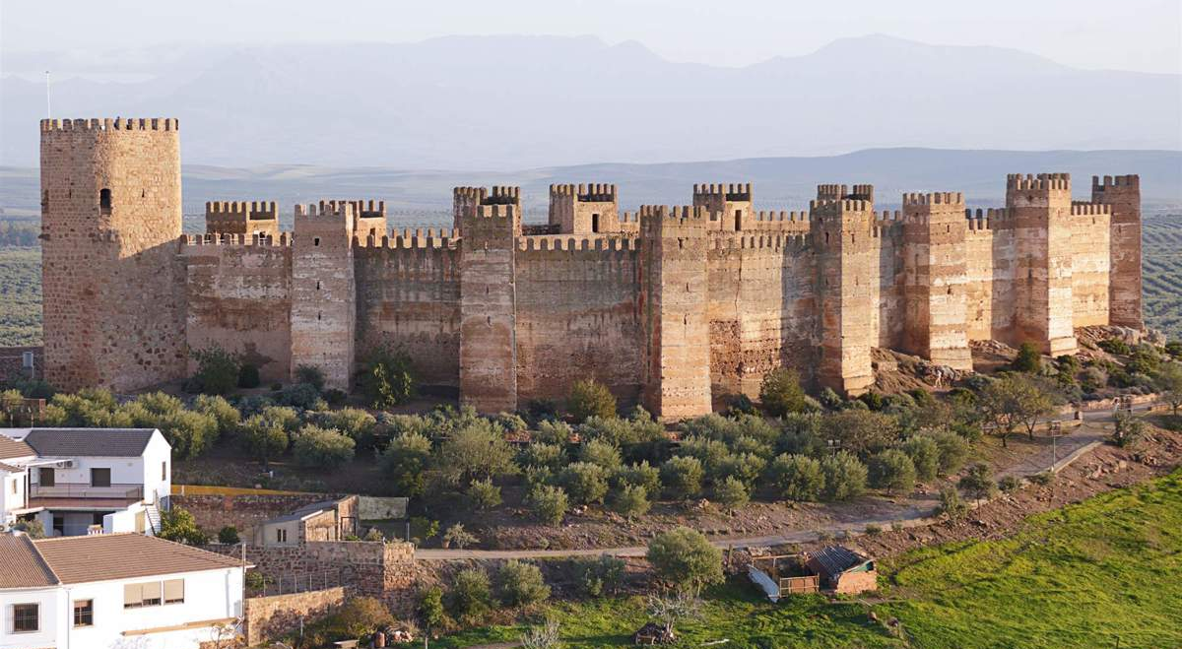
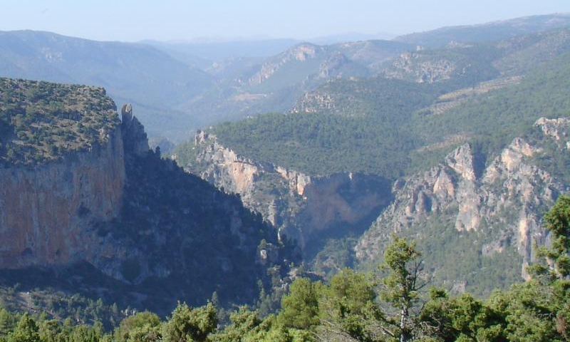
Universidad de Jaén
Why coming to Jaén ?
Jaén is an open city with an active social and cultural life, located in the heart of Andalusia.
Jaén is also a province with a unique natural, historical, artistic and cultural heritage:
capital of the olive oil (20% of world production)
The province with the most fortresses in Spain (historical border)
Spain's largest area of protected natural sites (3042 km2), including 4 parks and biosphere reserves.
Andalusian Renaissance (Jaén Cathedral, UNESCO: cities of Úbeda and Baeza)

Slide 4
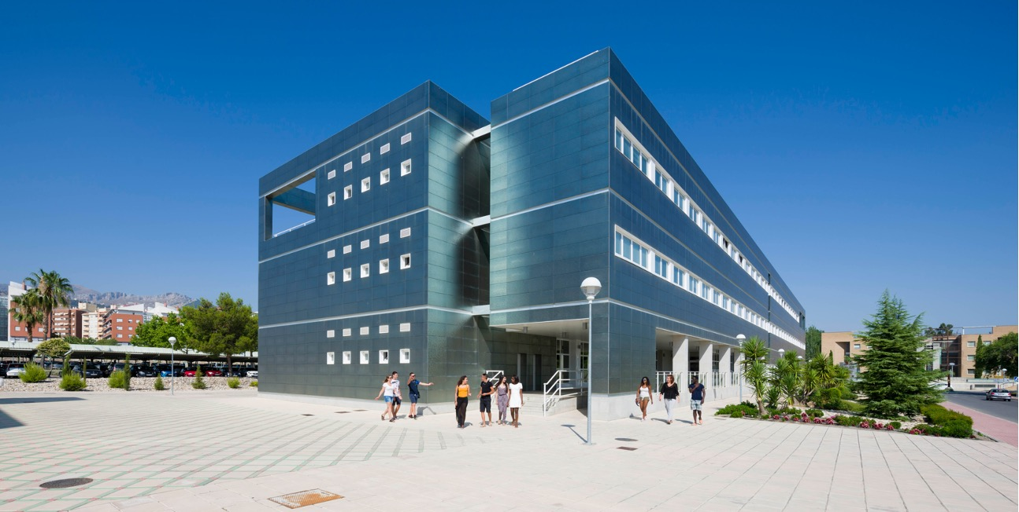
Universidad de Jaén
Our University
The University of Jaén is a young university (founded in 1993), with a constant training of teaching staff and a commitment to research.
Counts with two campuses accommodating 16,000 students and 1,600 employees, in modern buildings and state-of-the-art laboratories
is one of the top 300 young universities in the world (200/impact) according to THE (Times Higher Education).
ranks among the top 4% of universities worldwide, according to the Ranking Center for World University Rankings (CWUR).
coordinator of the Alliance of European Universities NEOLAiA, formed by 9 universities and funded by the European Commission with 14.4 million euros.

Slide 5
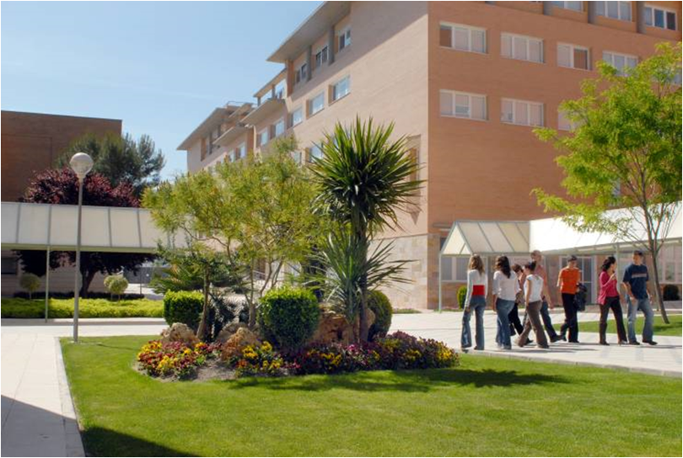
Universidad de Jaén
Our structure
Faculty of Health Sciences
Faculty of Experimental Sciences
Faculty of Social and Legal Sciences
Faculty of Humanities and Education
Faculty of Social Work
Higher Polytechnic School of Jaén
Higher Polytechnic School of Linares
Center for Post-Graduate Studies
Doctoral school
Center for continuing education and further training

Slide 6
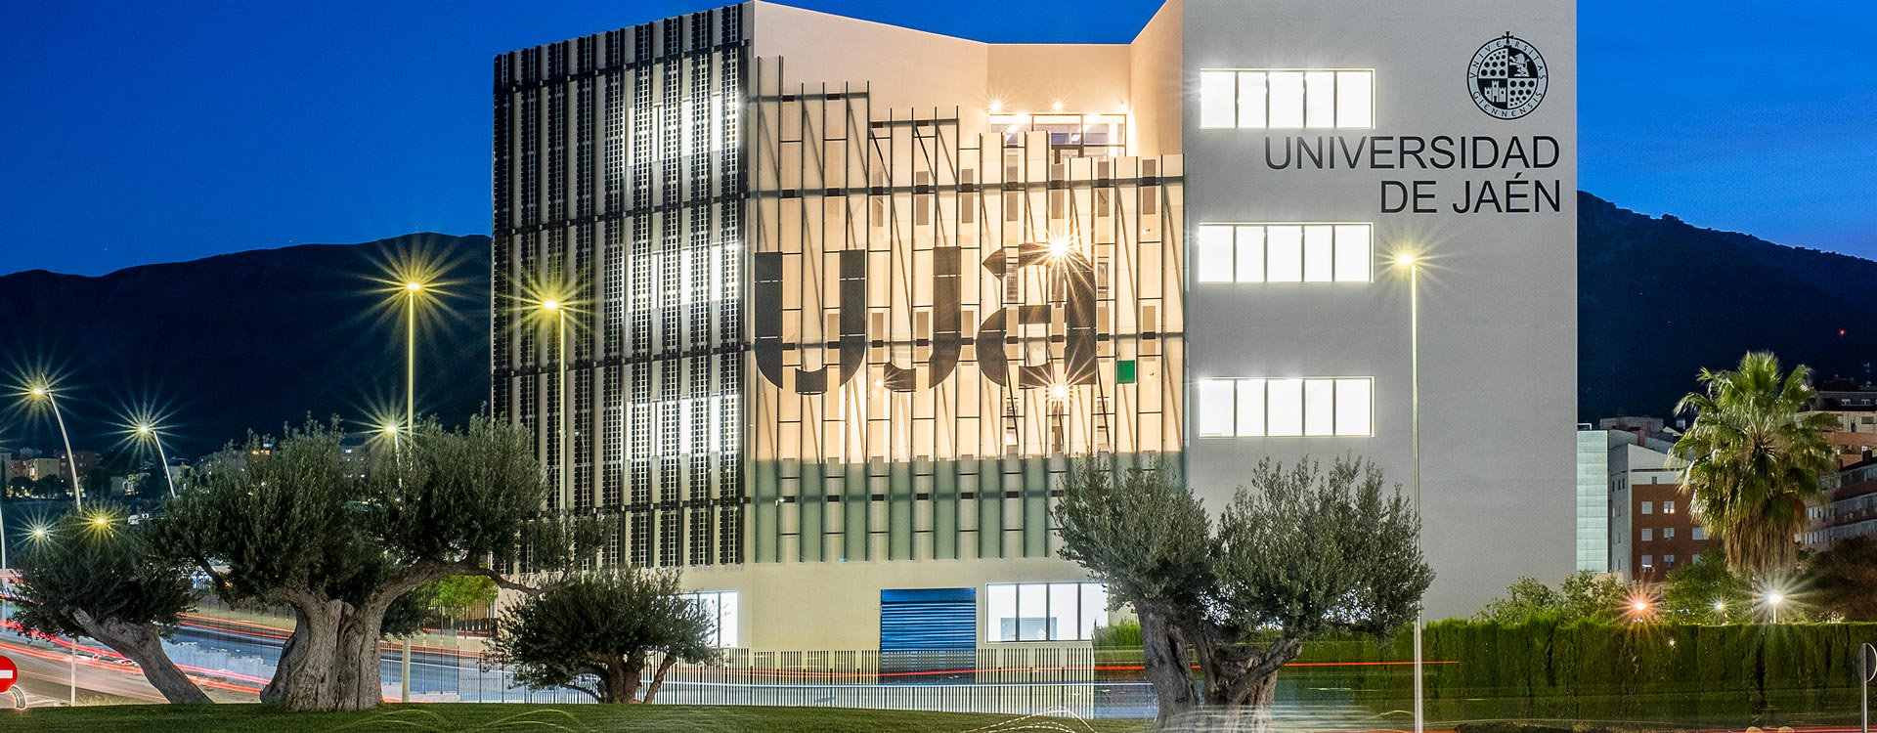
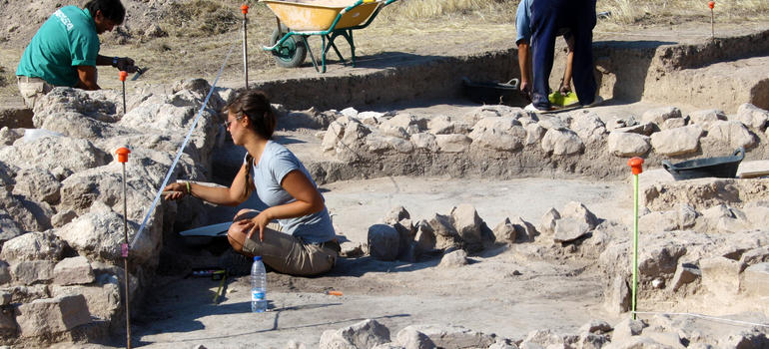
Universidad de Jaén
Research centres and institutes
Institute for Research in Iberian Archaeology
Center for Advanced Studies in Earth, Energy and Environmental Sciences
Institute for Olive Grove and Olive Oil Research
Center for Advanced Studies in Information and Communication Technologies
Andalusian Interuniversity Earth System Research Institute (IISTA)
Andalusian Interuniversity Research Institute for Data Science and Computer Intelligence
European Institute for Sustainability in Management
Interuniversity Institute for Biofuels and biorefinery.

Slide 7
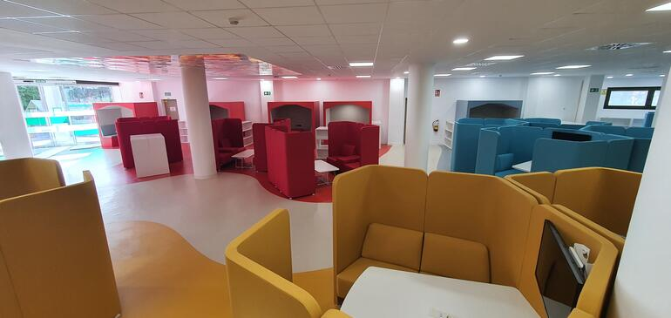
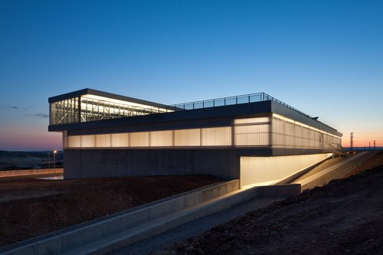
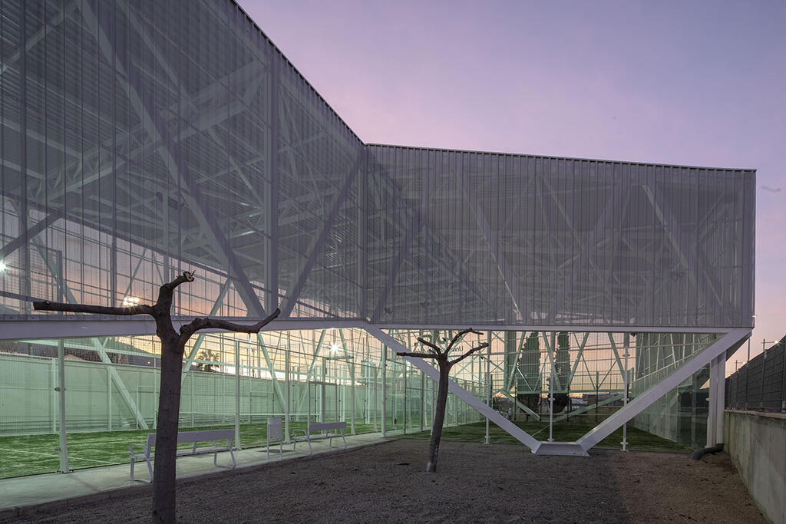
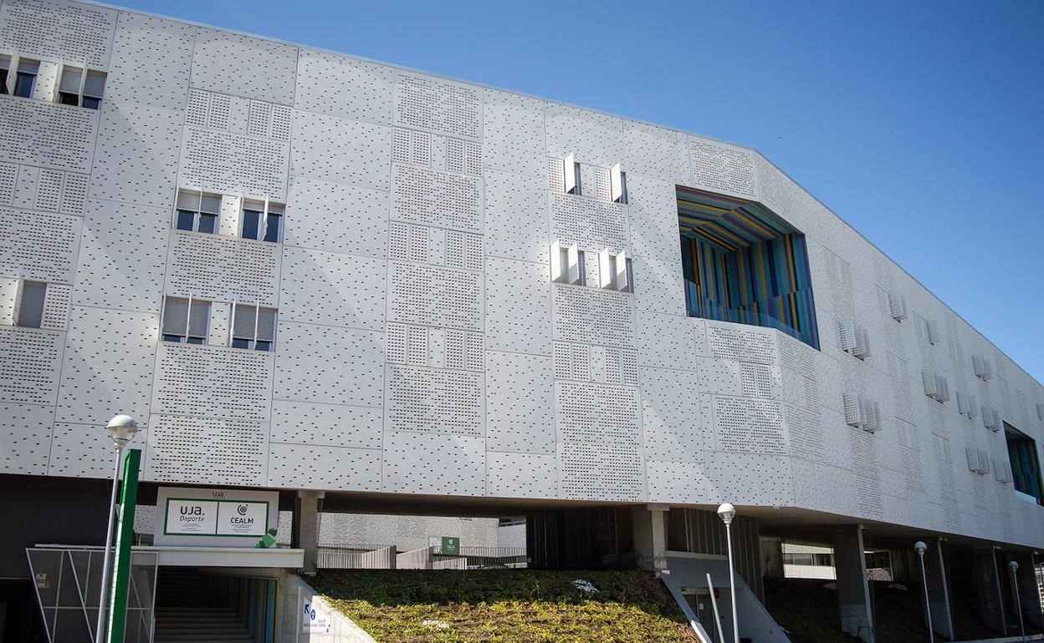
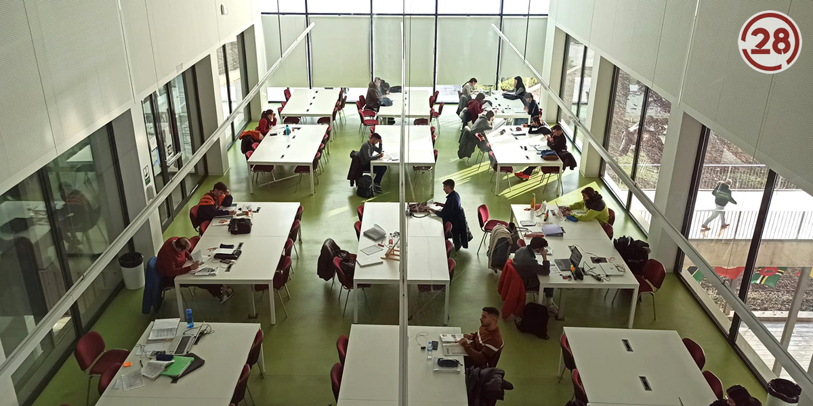
Universidad de Jaén
Modern resources
Educational resource center
Recording studios
Modern language center
Libraries
Sports centers, soccer field
Accommodation (on/off campus)
Restaurants, stores...

Slide 8
Universidad de Jaén
Bachelors
Social and legal sciences: 16
Arts and humanities: 7
Sciences: 3
Health sciences: 4
Engineering: 22
10 international double degrees: Civil Engineering, Mechanical Engineering, Languages, Tourism, Business Administration and Law
Total: 52 Bachelor's degrees

Slide 9
Universidad de Jaén
Master degrees, doctoral programs and lifelong diplomas
8 International double degrees
3 online degrees
15 partially online degrees
Doctoral programs: 20
9 Inter-university programs
Master's degrees, specializations and post-graduate diplomas: 50+.
Total: 55 master's degrees

Slide 10
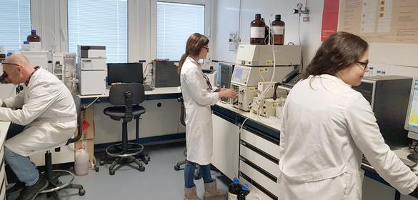
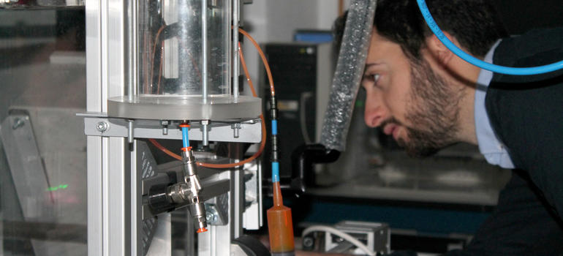
Universidad de Jaén
Research groups
Humanities
Economic, social and legal sciences
Natural resources and environment
Production technologies
Physics, chemistry and mathematics Health sciences and technologies
Biology and biotechnology
Information and Communication Technologies
Agri-food
Total: 287 groups

Slide 11
Universidad de Jaén
International Research Projects
Very active institution as participant in European framework programs (H2020, HE)
H2020: 180 proposals submitted / Horizon Europe: 74 proposals submitted
23 projects financed (€4,552,696.95) under H2020 and HE (including MSCA ITNs).
20 additional funding projects (€3,738,192.53) in other international programs: Life2027, Interreg Euro-MED, CET Partnership, Water4all, Gerda Henkel Foundation, NATO...
Subjects: materials, olive growing, renewable energies, telecommunications, biodiversity, ecology, ICTs

Slide 12
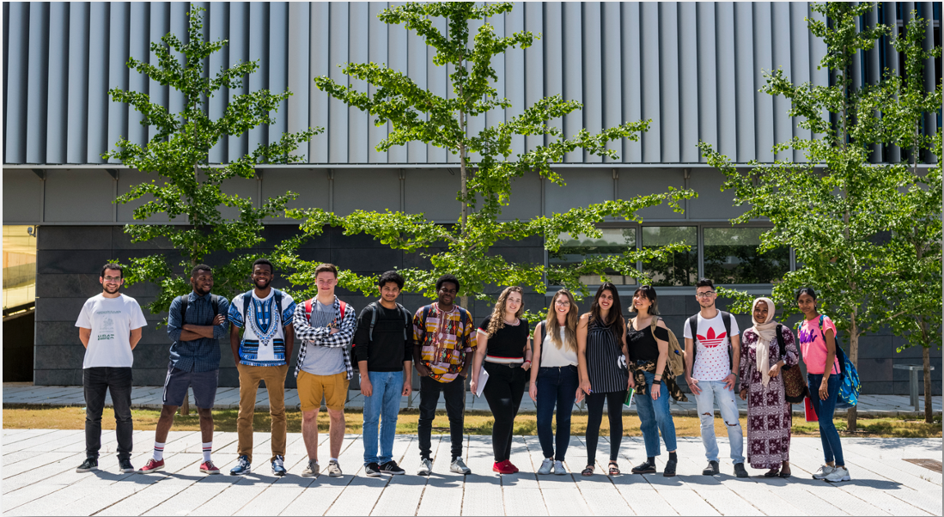
Universidad de Jaén
Internationalisation
1,500+ agreements with over 750 international institutions from more than 60 countries
700+ internationally mobile students (incoming)
International students at UJA: 1,700+ from five continents
Over 500 mobility students at UJA
18 international double degrees (bachelor's and master's) in engineering, languages, business and law
Bachelor's degrees in English: (telecommunications, English studies, bilingual education, business administration and management)
300+ courses offered in other languages

Slide 13
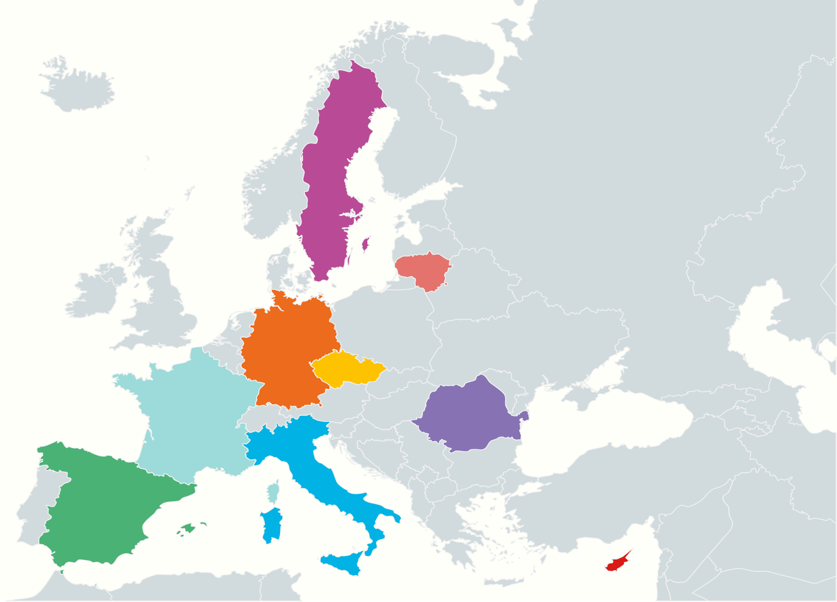
Universidad de Jaén
Internationalization Projects
Leading Spanish university in terms of Erasmus+ KA171 funding for external mobility (non-EU countries)
Regular participation in Erasmus+ KA2 and KA3 projects (overall funding of €3M)
Coordinator of the European University Alliance project (NEOLAiA), funded by the European Commission with €14,400,000.
University of Jaén (ESP) - Coord.
University of Örebro (SWE)
University of Bielefeld (GER)
University of Nicosia (CYP)
University of Ostrava (CZE)
University of Salerno (ITA)
Stefan Cel Mare" University of Suceava (ROM)
University of Tours (FRA)
Šiauliai University of Applied Sciences (LIT)

Slide 14
Universidad de Jaén
More useful information
Scholarships for international students
100% tuition free
Scholarship of €2,200 (Bachelor's)/€3,000 (Master's) per year per applicant
Health insurance for the duration of the scholarship
Free Spanish courses for non-Spanish-speaking students
Visiting professors program
Spanish courses
Introductory course (at the beginning): September and January
Extensive courses (after a placement test): September - May (5 hours per week)
Intensive courses: October - July (hours per week)

Slide 15
Universidad de Jaén
Thank you very much for your attention!

