Slide 1
Welcome to your Erasmus!
September 2026

Slide 2
What is ESN?
ESN = Erasmus Student Network

Slide 3



What is ESN?
Non-profit international student association
“Students helping Students”
We help you integrate in the local culture

Slide 4
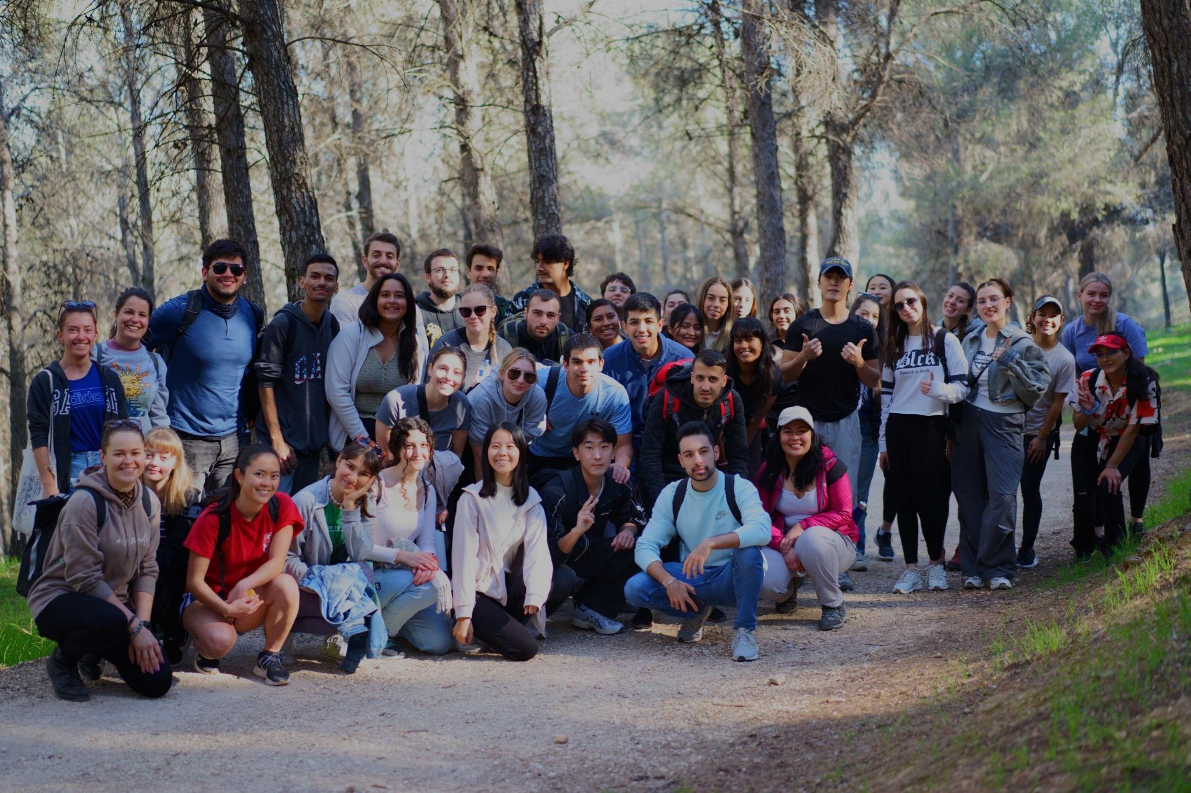
ESN Jaén

Slide 5
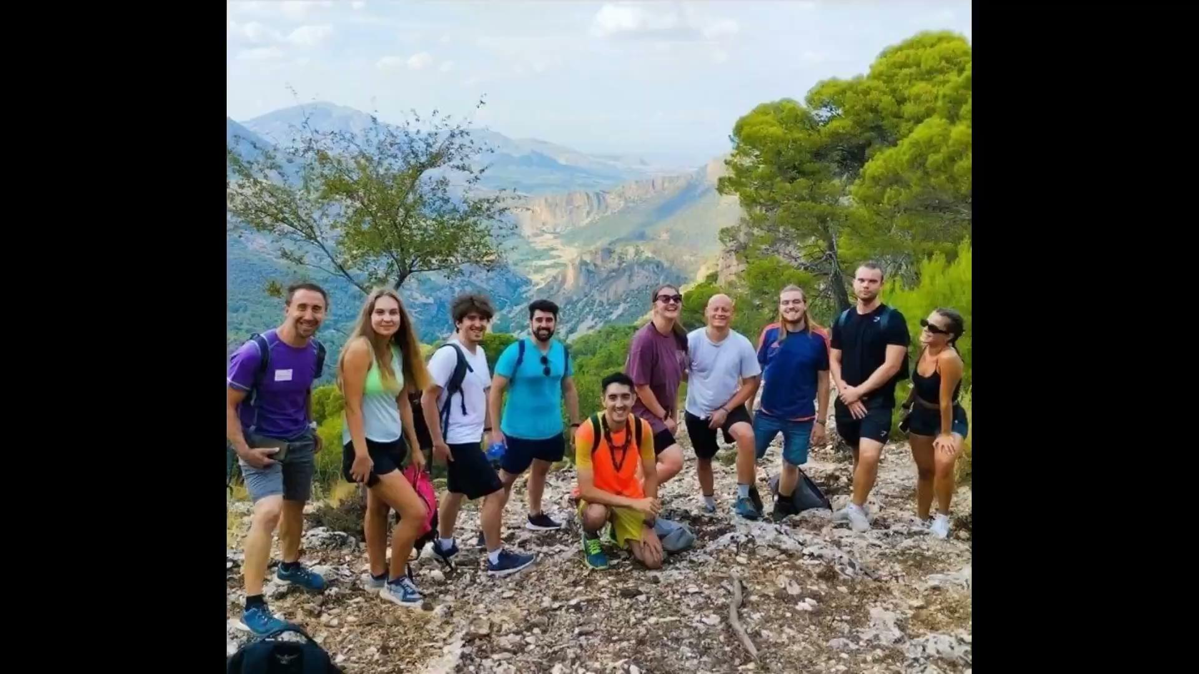

Slide 6

WHAT DOES THIS LOGO MEAN?

Slide 7
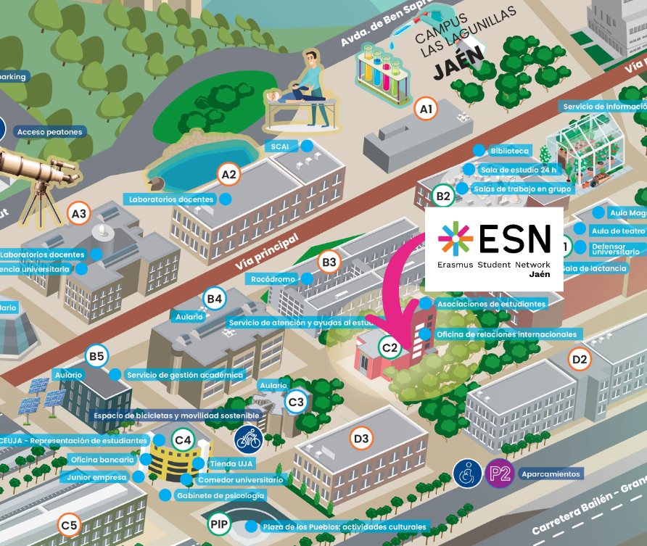

Where can you find us?

Slide 8
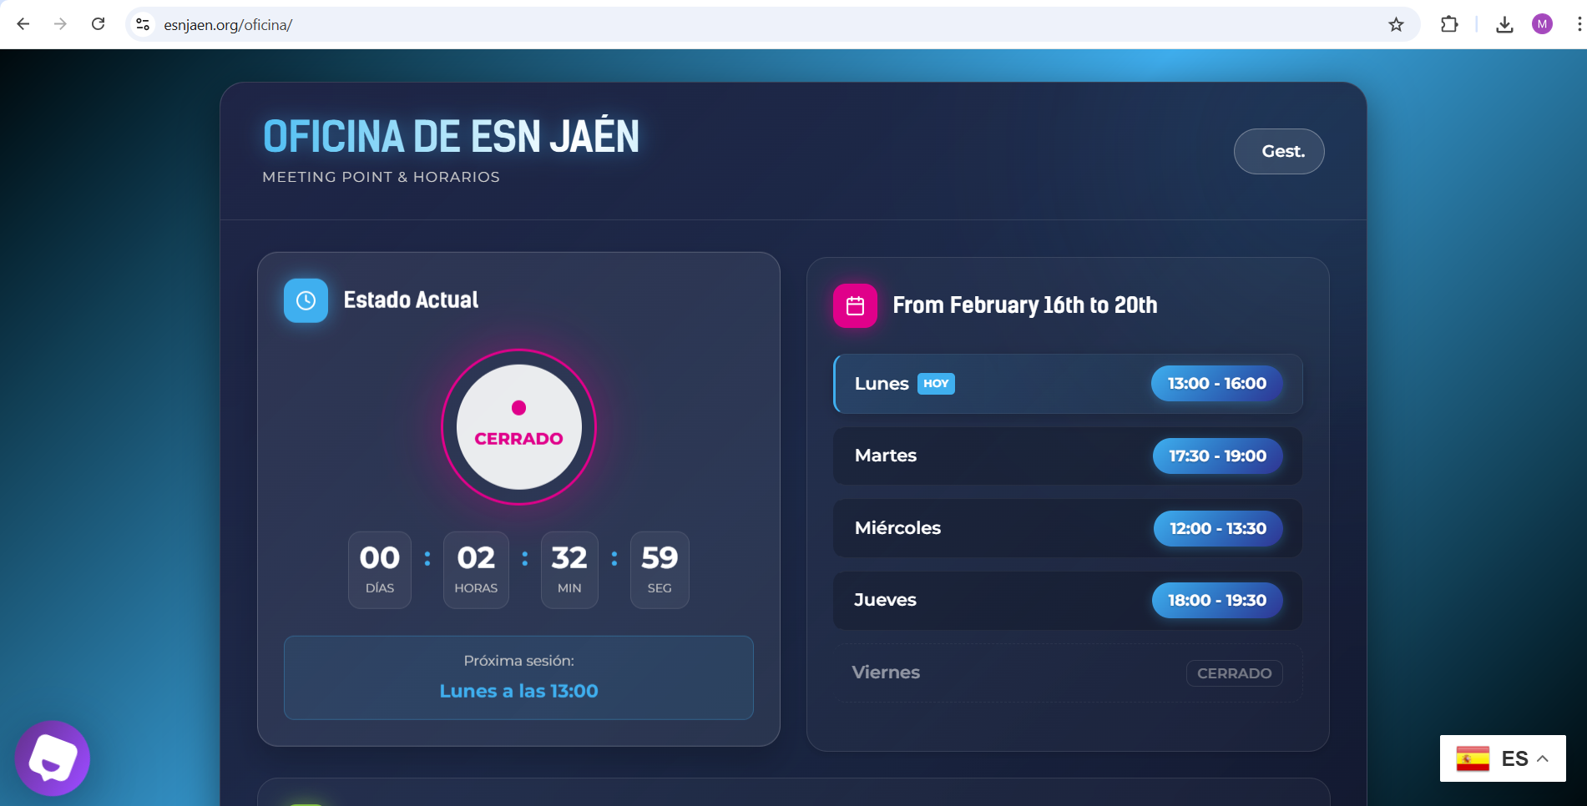
Office Details

Slide 9
Want to join us?
ESNcard, your new best friend

Slide 10

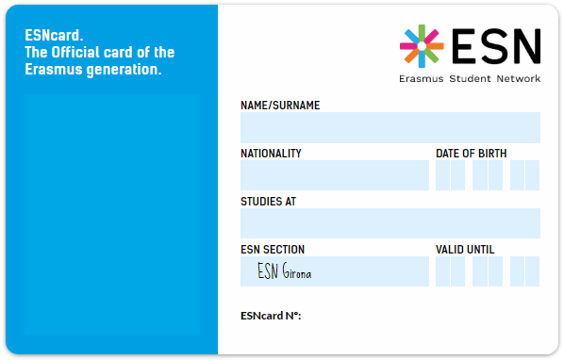






ESNcard
Membership card
…and many more!!!

Slide 11
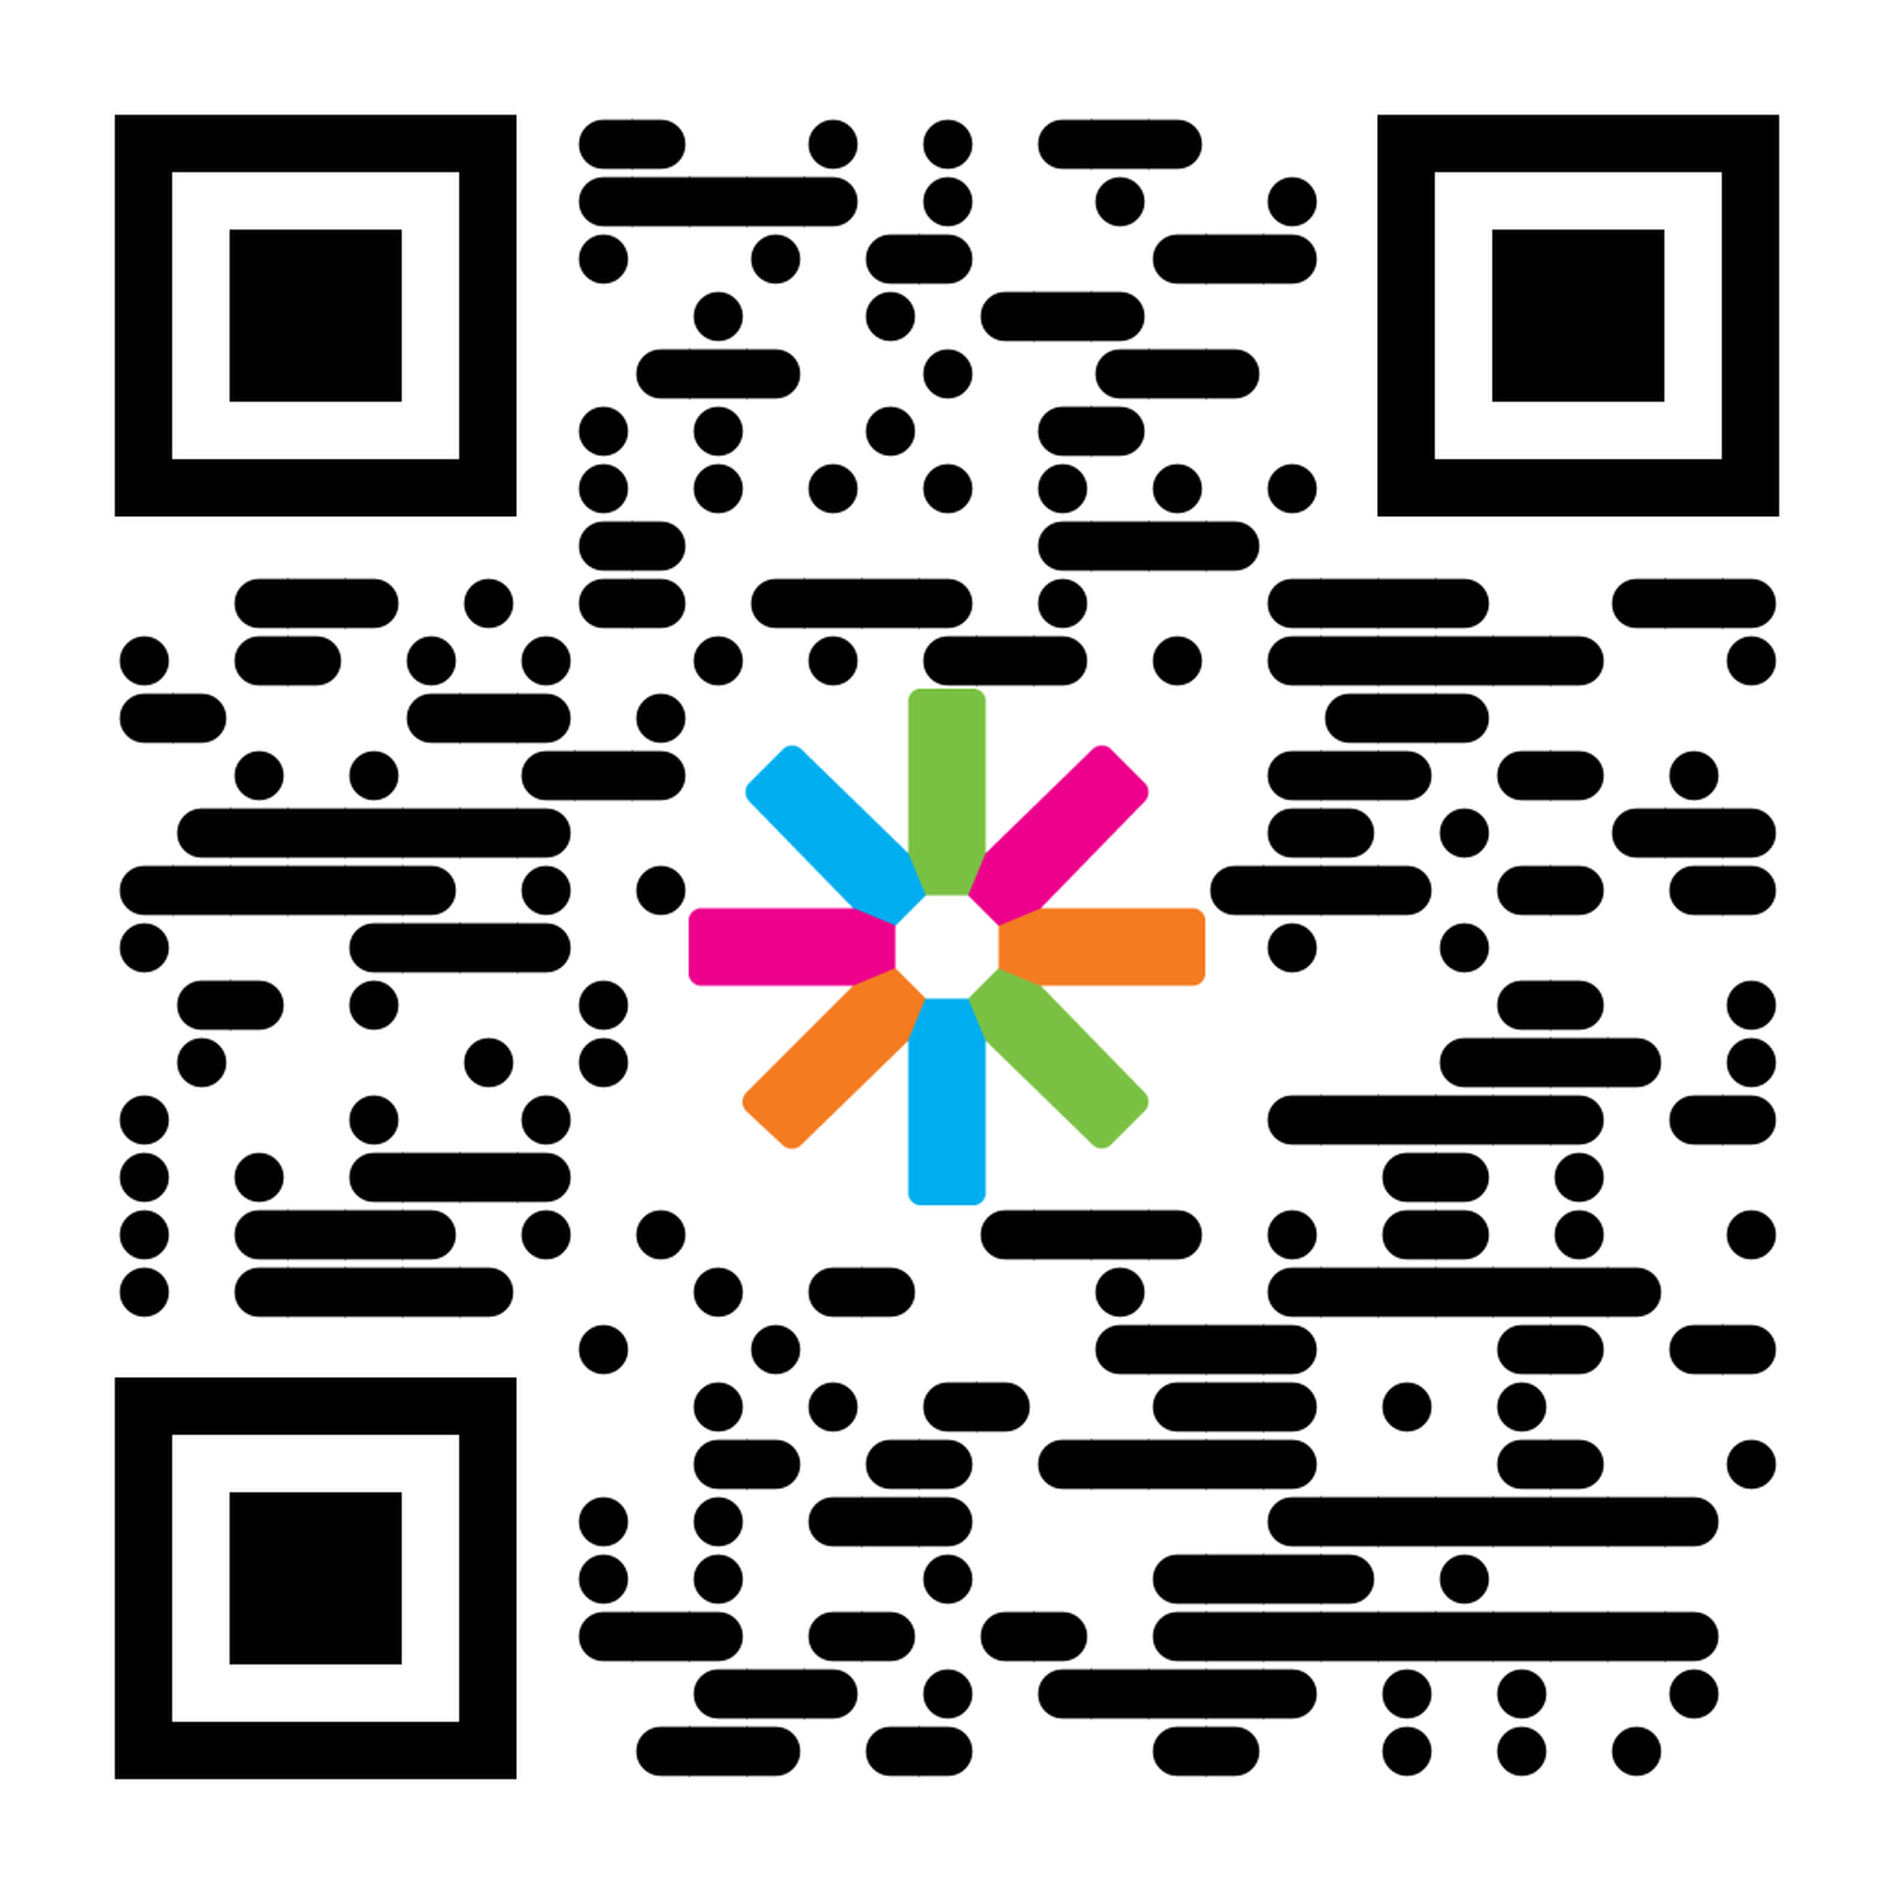

What to do?

Slide 12
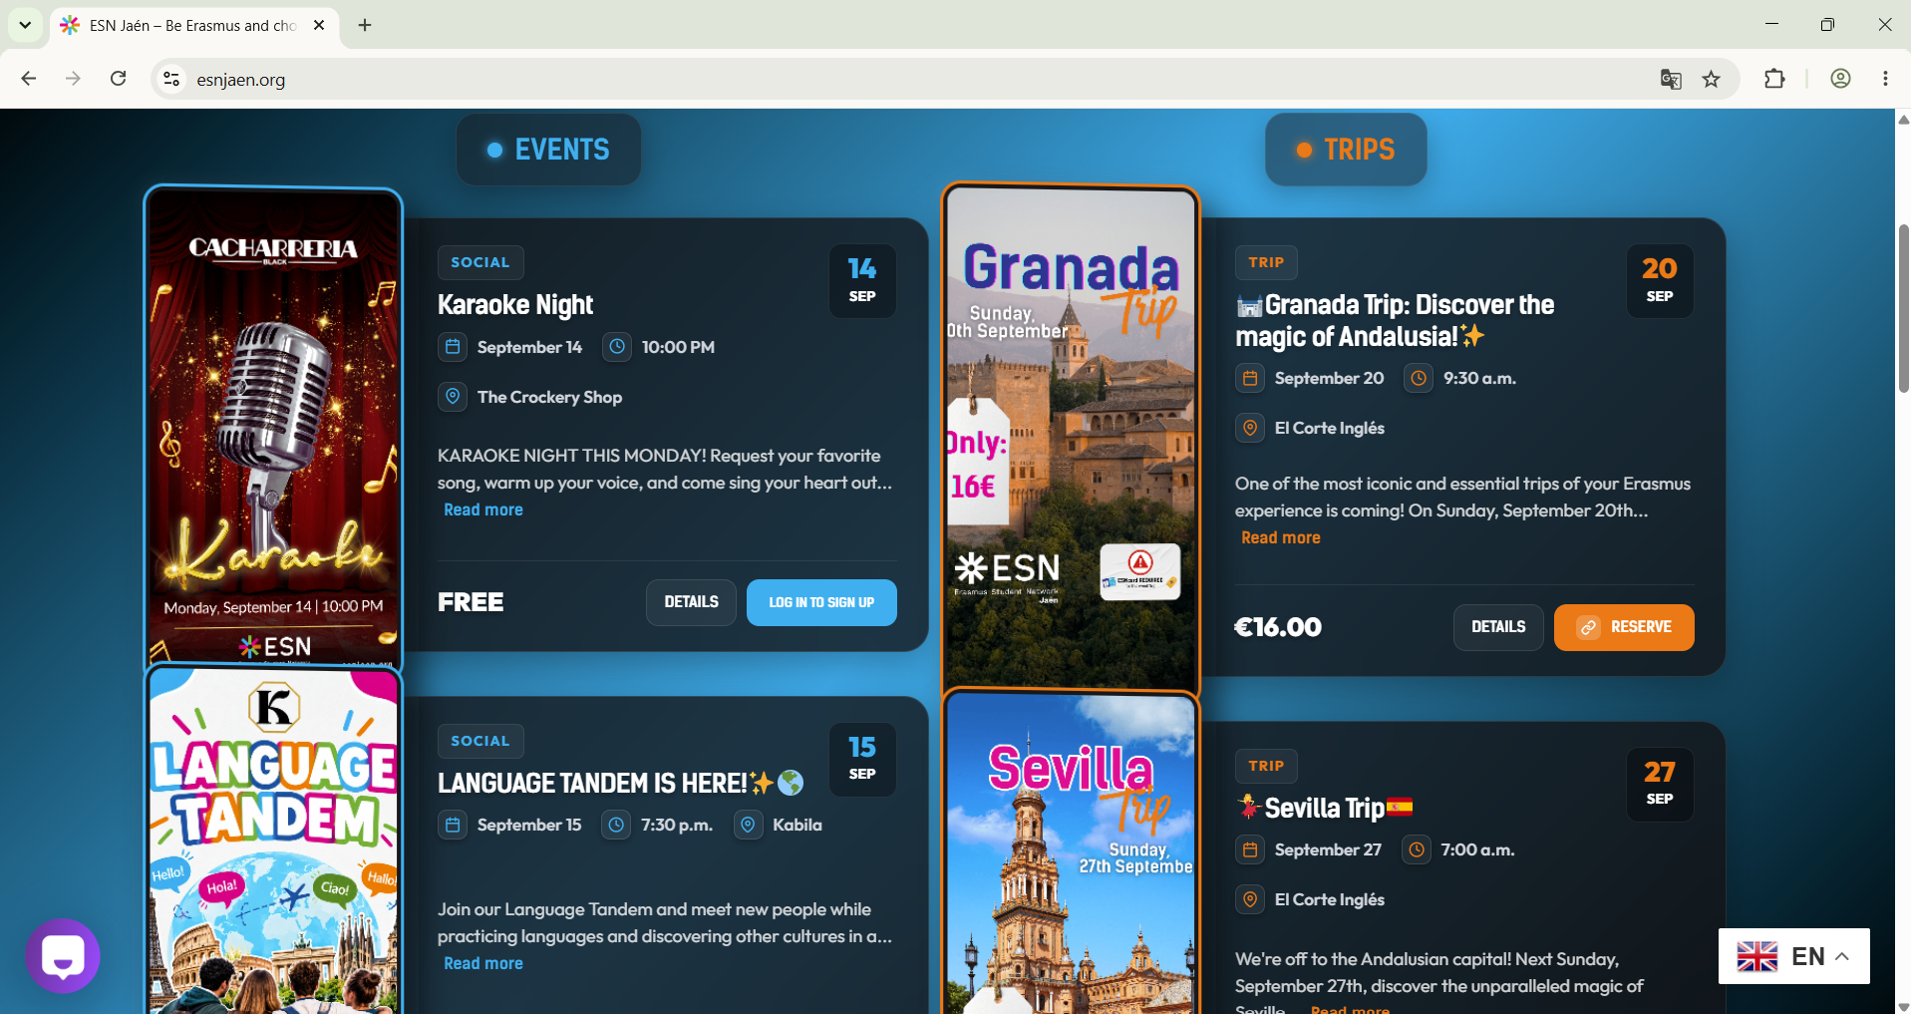

Slide 13
SOME ADVICE FROM US?

Slide 14
Meet new people and be yourself!

Slide 15

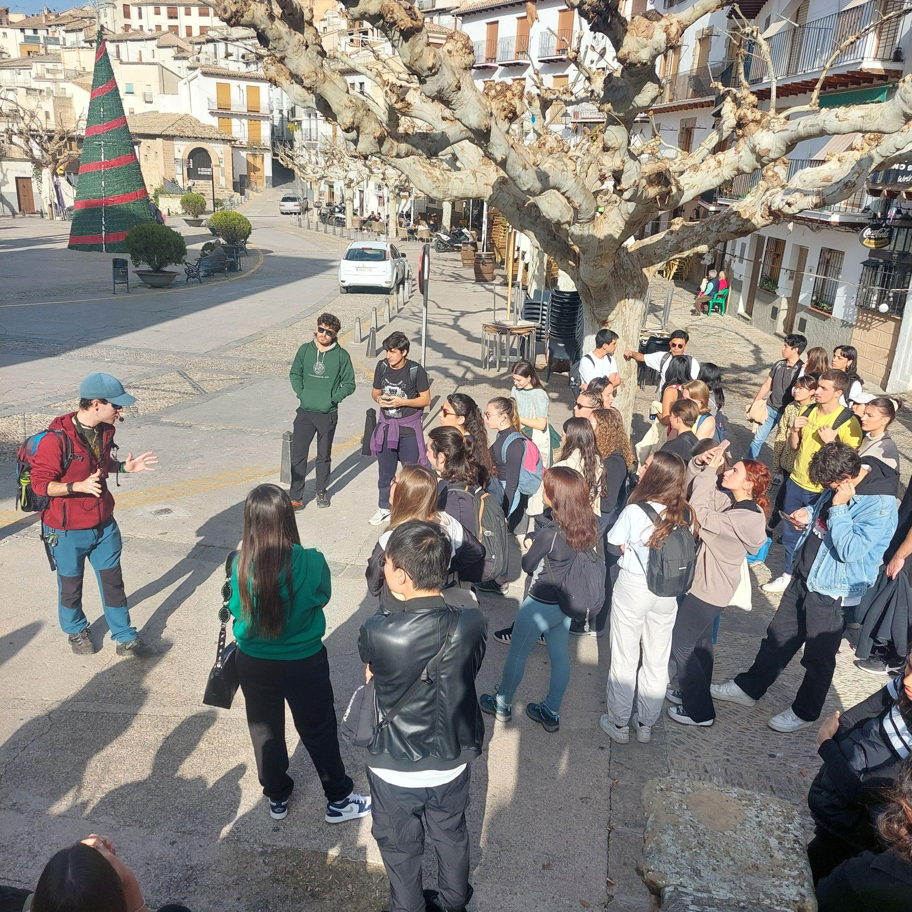
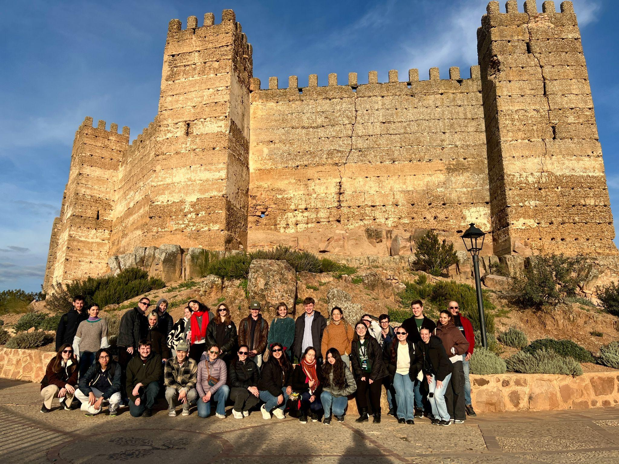

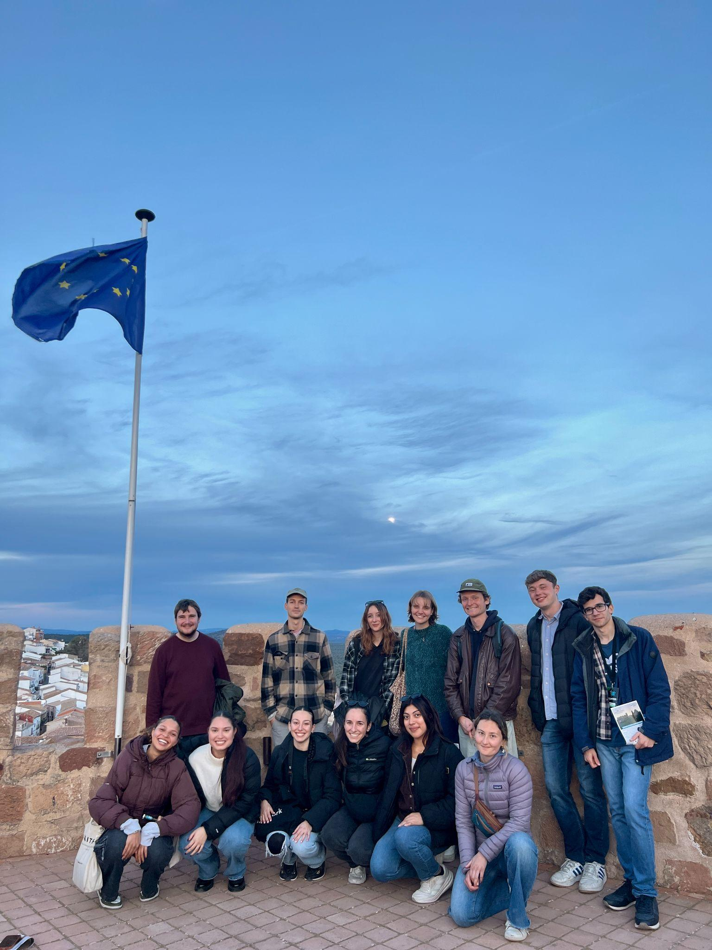
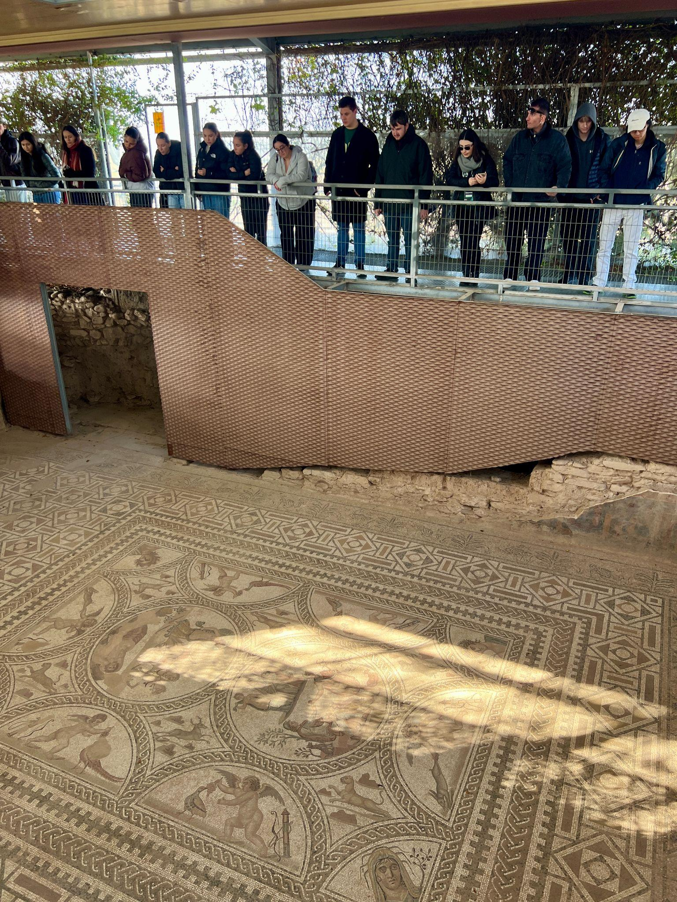
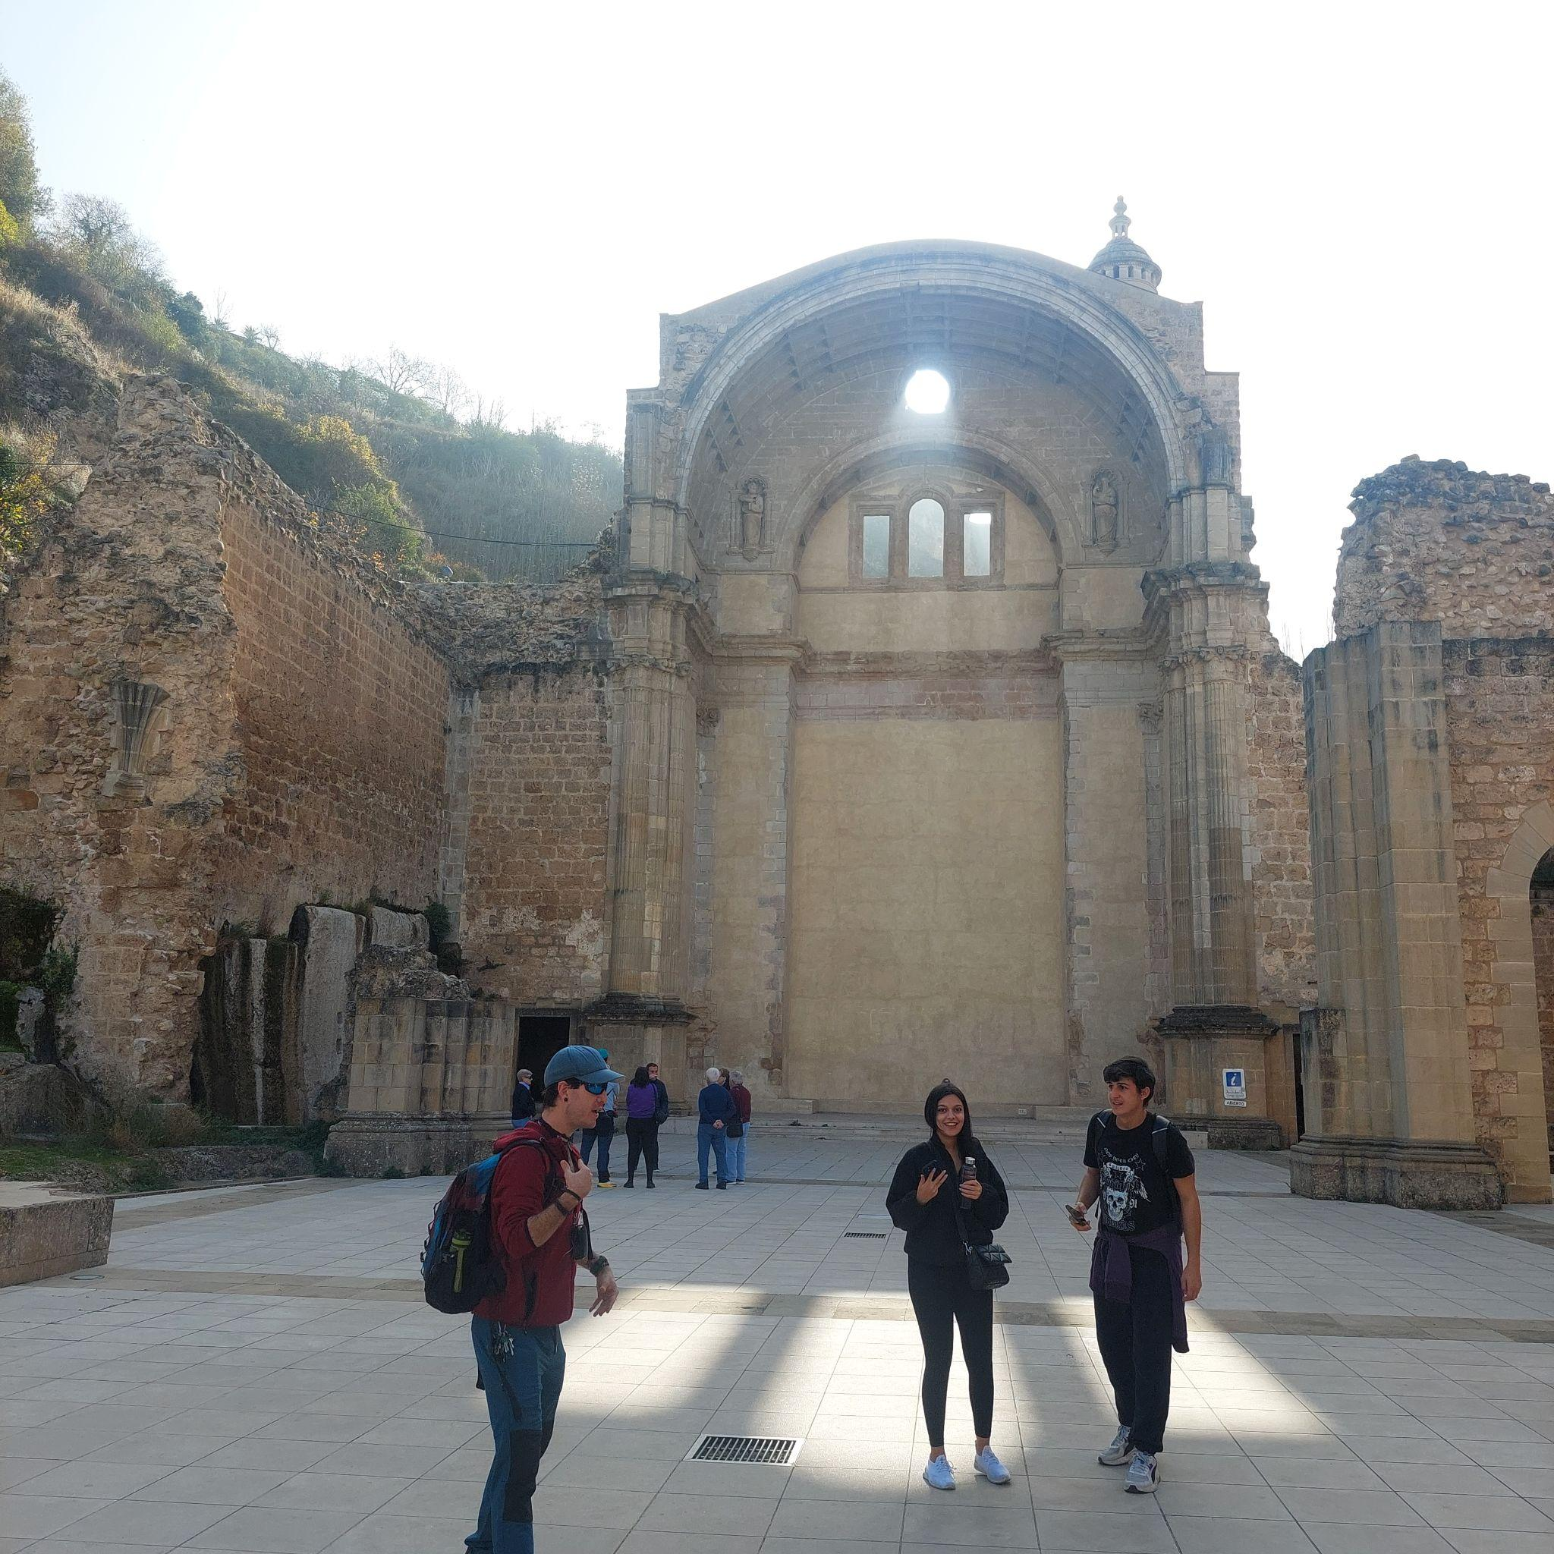
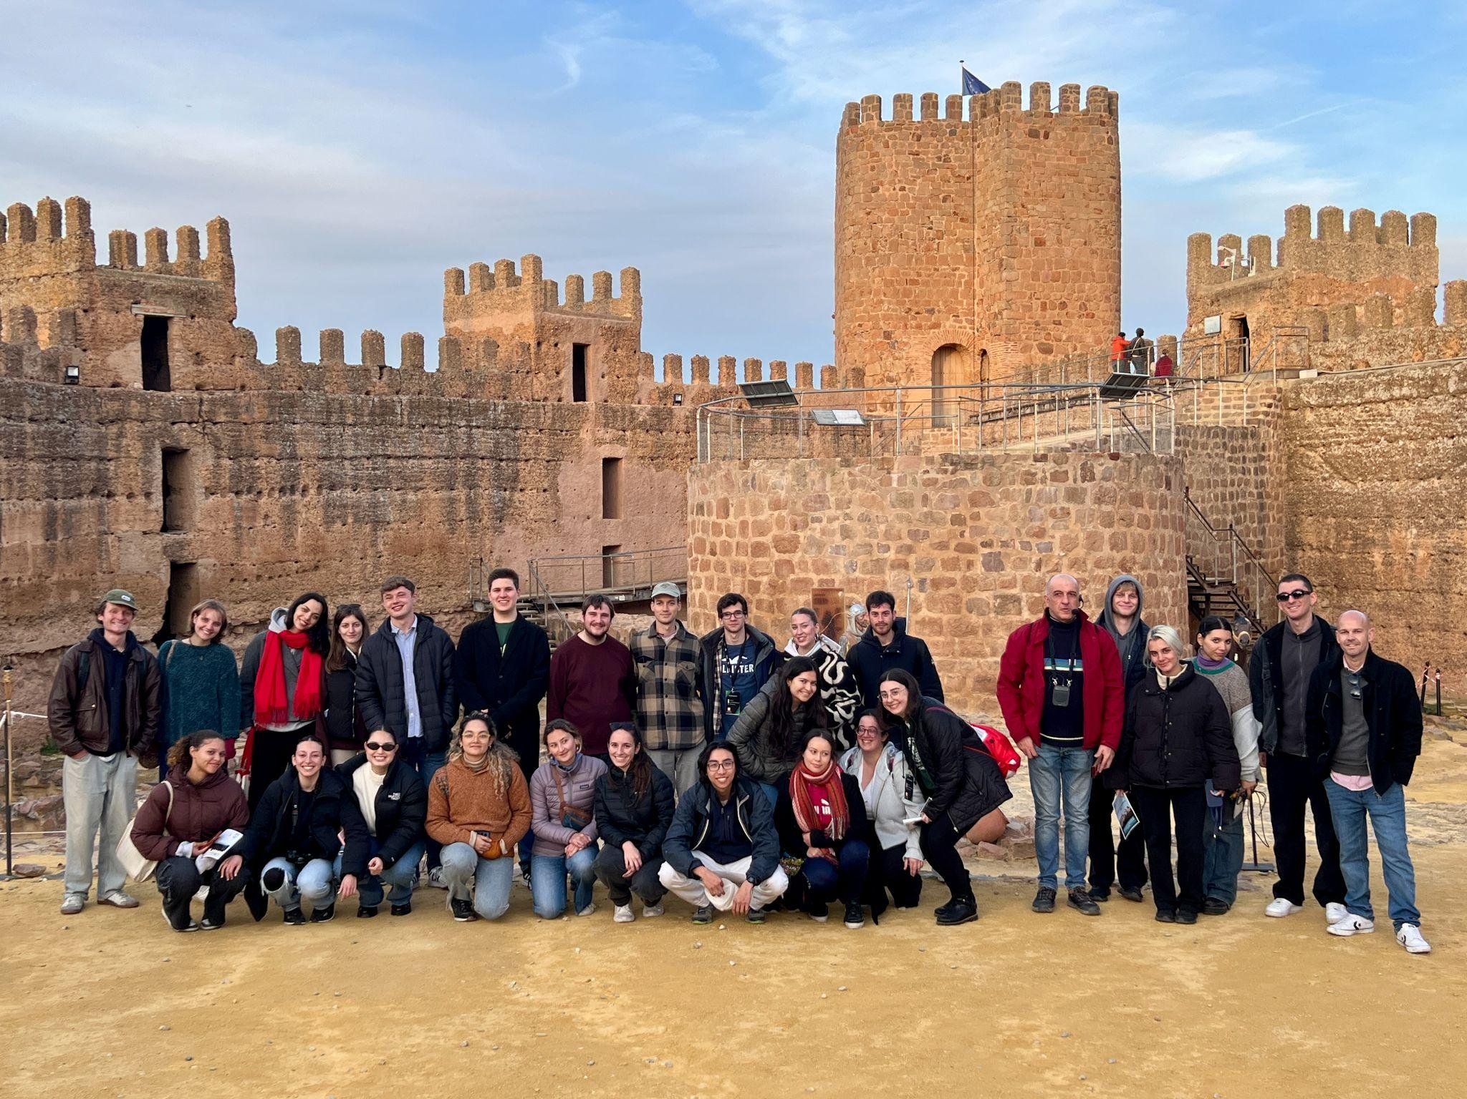
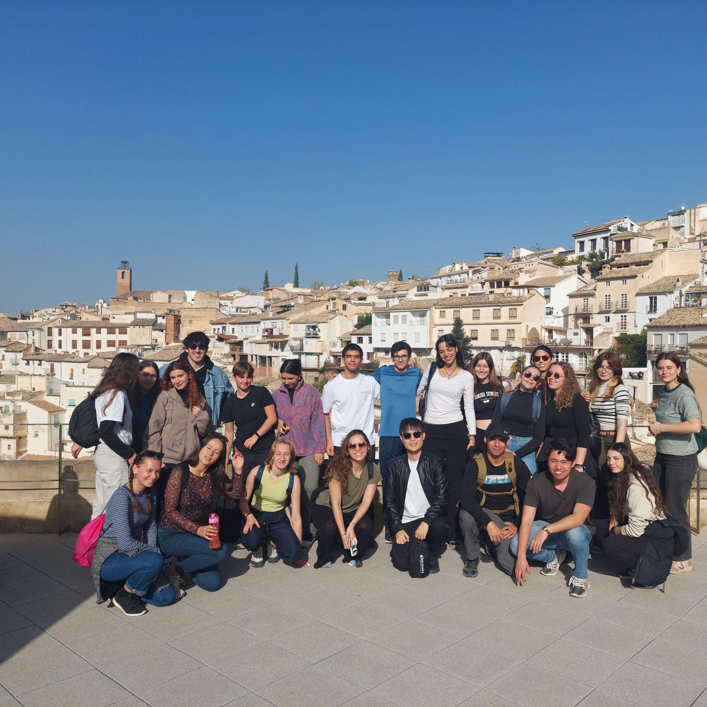
Travel

Slide 16
Be open to engage with people from different nationalities and diverse cultures!

Slide 17
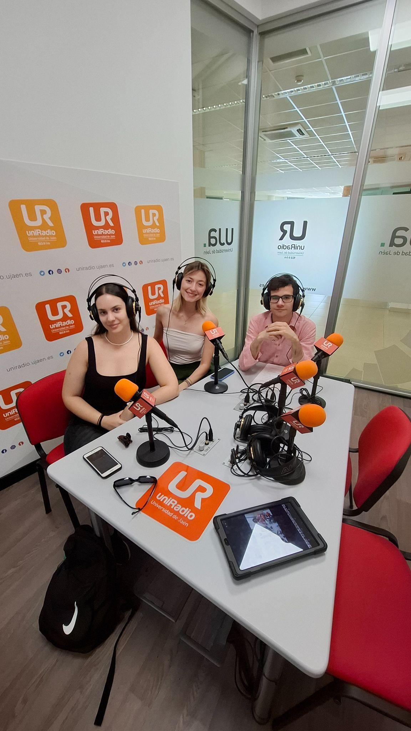

Learn languages & share your culture!

Slide 18




Where can you find us online?
www.esnjaen.org
@esn_jaen
ESN Jaén
WhatsApp Group
info@esnjaen.org

Slide 19
Enjoy your stay!
“Erasmus is not just a year in your life but…”
The ESN Jaén Team

